Slide 1
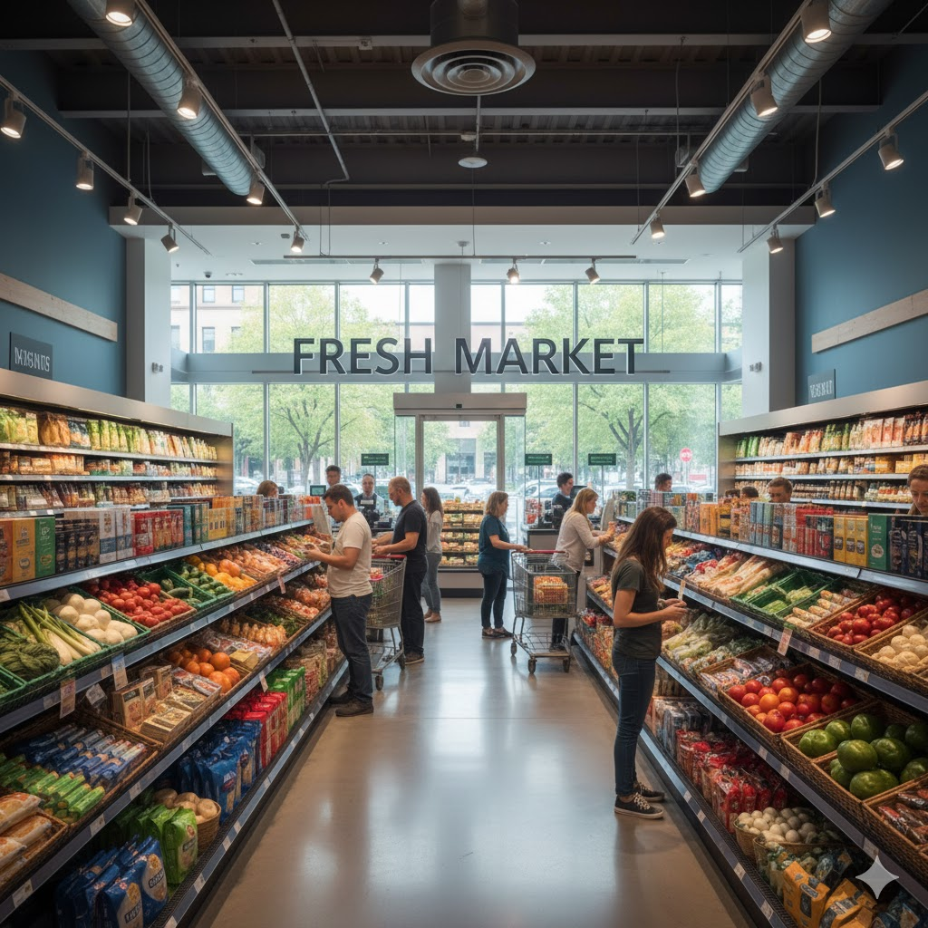
Marketing and Retail Analysis – Project 2
Market Basket Analysis – Grocery Store data
James Kagwe
Masters Program in Data Science and Business Analytics

Slide 2
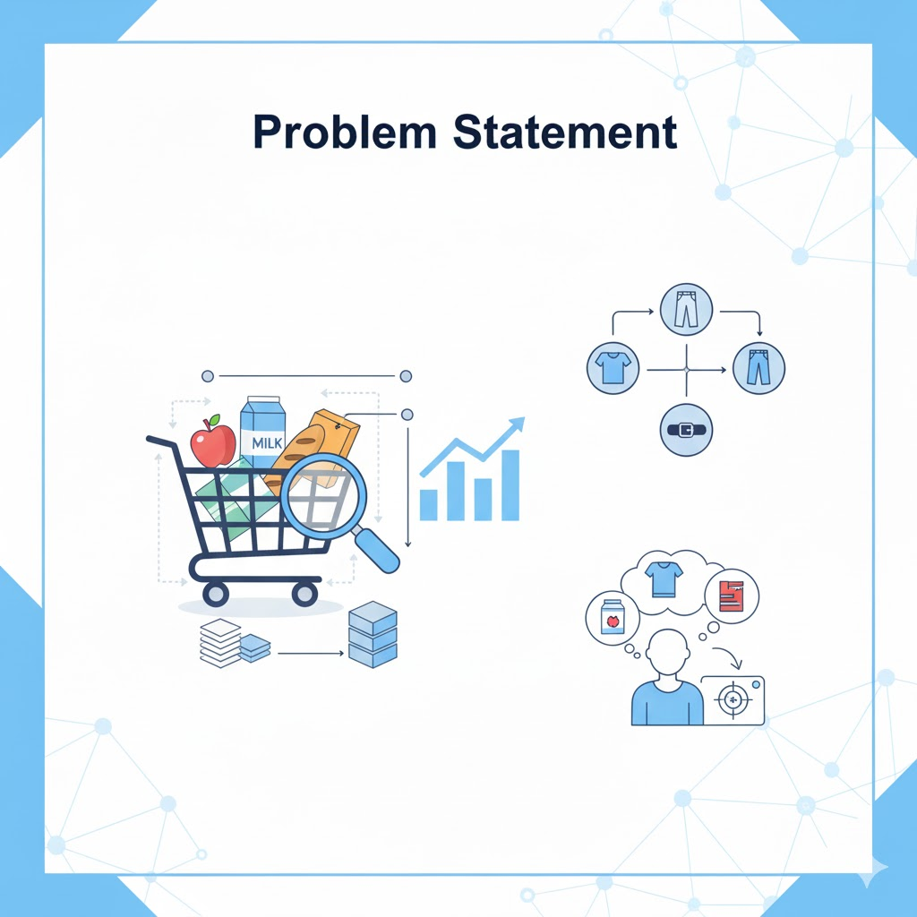
A grocery store shared the transactional data with you. Your job is to conduct a thorough analysis of Point of Sale (POS) data, identify the most commonly occurring sets of items in the customer orders, and provide recommendations through which a grocery store can increase its revenue by popular combo offers & discounts for customers.

Slide 3

Exploratory Data Analysis
and Inferences

Slide 4
Summary of the data:
Objective: The objective is to analyze Point of Sale (POS) data to uncover frequently purchased combinations of items in customer orders. The outcome will be actionable recommendations for new combo offers and discounts designed to increase store revenue and boost customer satisfaction.
The analysed dataset consists of 20,641 rows and 3 columns, representing the Point of Sale (POS) data from a grocery store.
The columns include 'Date', 'Order_id', and 'Product’ of Date, integer and object data types
The dataset does not contain any missing values.
Duplicate Values: There are 4,730 duplicate values present in the dataset. Although there are duplicate values in the dataset, it is not necessary to remove them. Each duplicate order ID corresponds to the purchase of different products, indicating that these duplicates represent unique transactions.
Market Basket Analysis helps the grocery store discover which items are commonly bought together by customers. This information can be used to create special deals and discounts on popular combinations of products, encouraging customers to buy related items. By using market basket analysis, the store can improve its sales strategies and better meet the preferences of its customers

Slide 5
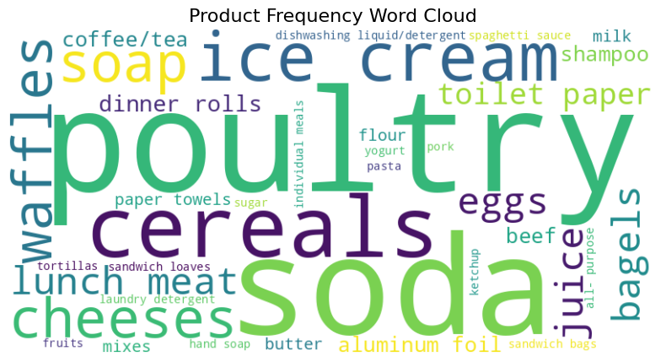
Product Frequency
Inference - The Word clod below reveals the top most occurring products in the dataset. The most common are Poultry, Soda, Cereal and Ice-cream. Ketchup, hand soap, fruits and pork are among the products that are trailing in demand. These findings highlight the popularity and demand for these specific products.

Slide 6
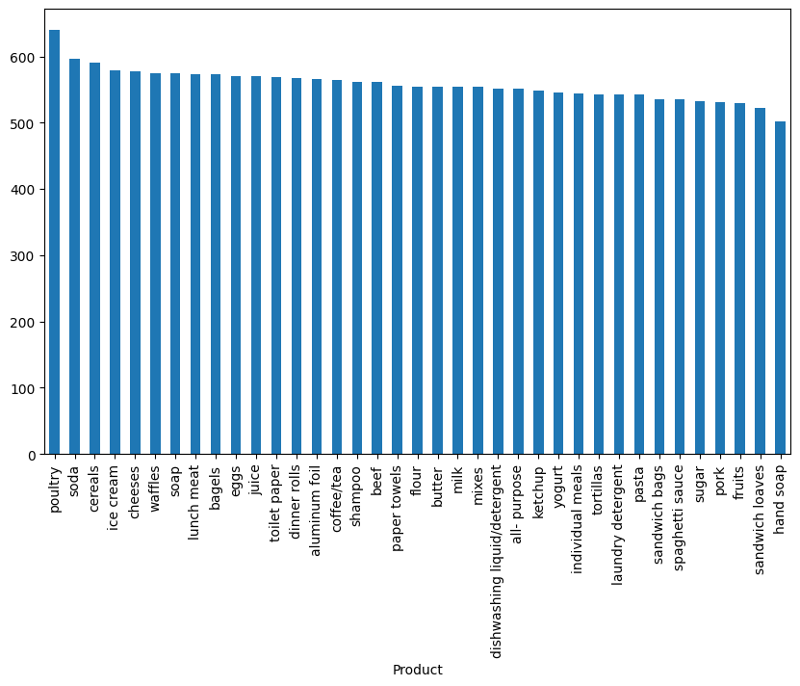
Product Frequency Contd……

Slide 7
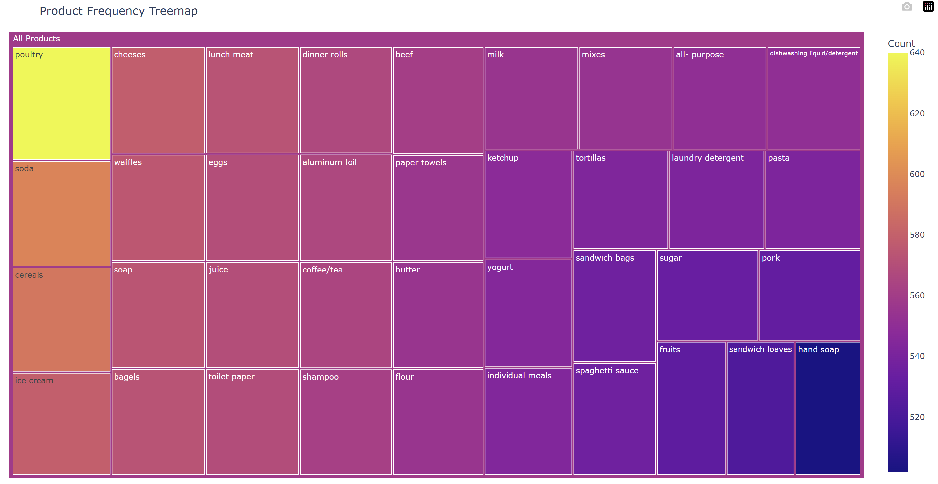
Product Frequency Contd……
The treemap analysis reveals the top most occurring products in the dataset, with Poultry having the highest count of 640, followed by Soda with a count of 597, Cereal with 591, Ice-cream with 579, Cheese with 578, and Waffles with 575. These findings highlight the popularity and demand for these specific products.

Slide 8
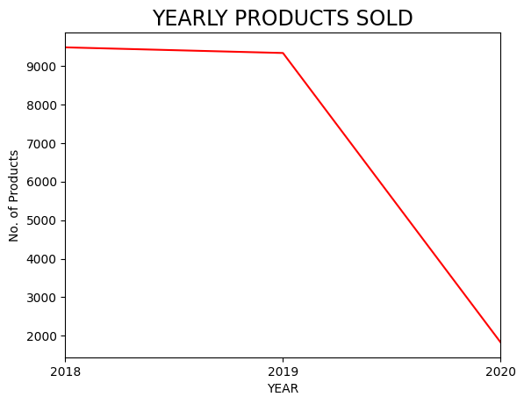
Products sold per Year
Based on the below data, it can be inferred that there was a relatively stable level of Product order activity from 2018 to 2019, with a slight decrease observed. However, further data and analysis is required to understand the trends and patterns for 2020, since its only data for the first two months of 2020 that was provided.

Slide 9
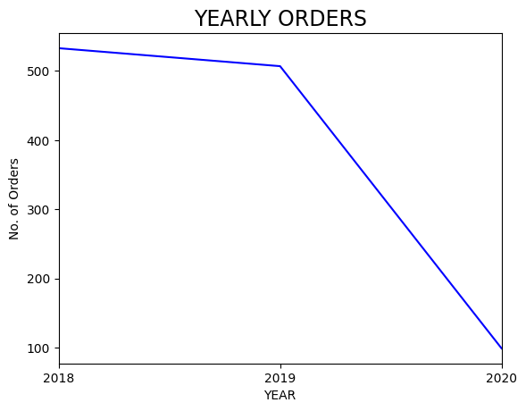
Order processed per Year
This is a reflection of product sold per year where 2018 and 2019 orders were fairly high. A decline is noted in year 2020. This needs further probing since it is based on the first 2 months of the year 2020 only.

Slide 10
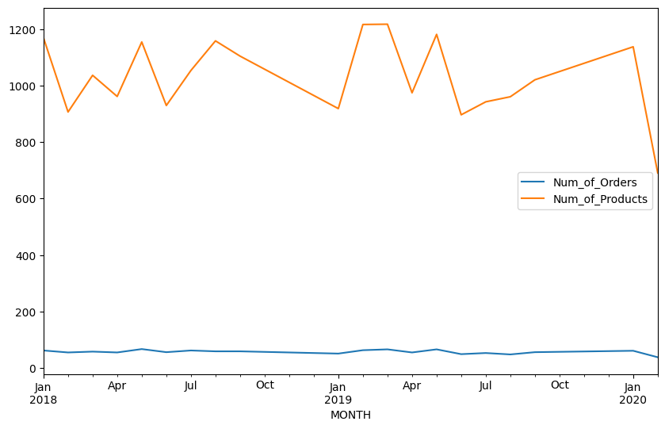
Number of Orders and Products Quarterly
Number of orders across the quarters is constant apart from in the year 2020 due to lack of sufficient data.
Number of products is erratic and needs to be investigated further to establish if there is any trend across the quarters.

Slide 11
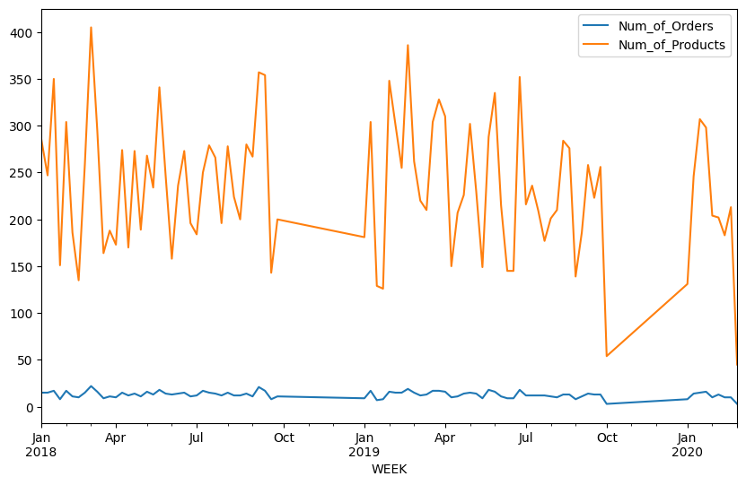
Number of Orders and Products Weekly
Number of orders across the weeks is erratic. It shows a downward trend in the year 2020 due to lack of sufficient data.
Number of products is erratic and needs to be investigated further to establish if there is any trend across the quarters.

Slide 12
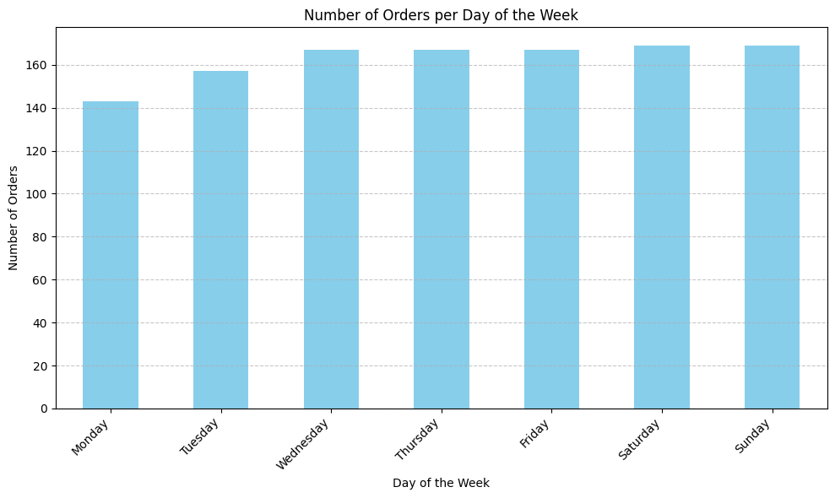
Number of Orders in Days of the Week
Number of orders across the days increase as the week progresses from Monday to Sunday

Slide 13
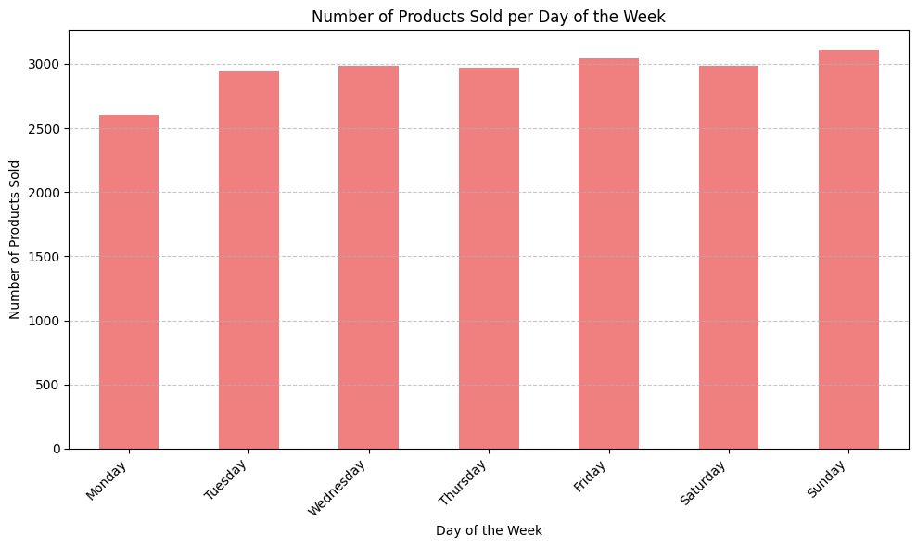
Number of Products in Days of the Week
Number of Products across the days increase as the week progresses from Monday to Sunday

Slide 14
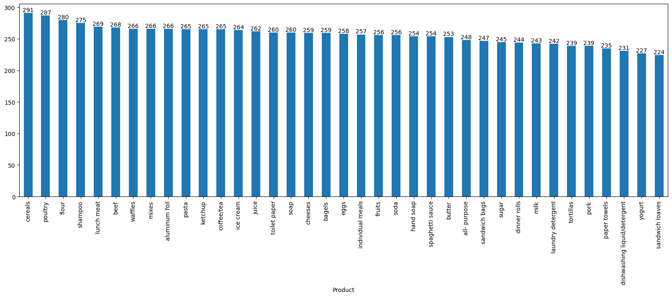
Top ordered products- 2018
The 2018 transaction data reveals that customer demand was highly concentrated across staple food items and select personal care products. The top five products accounted for a significant portion of orders, with the highest-ranked item (Cereals) only exceeding the lowest-ranked item (Lunch Meat) by 22 orders, indicating a tight competition among the top performers.
Rank | Product | Number of Orders | Demand Type
1 | Cereals | 291 | Staple/Breakfast
2 | Poultry | 287 | Staple/Protein
3 | Flour | 280 | Cooking Staple
4 | Shampoo | 275 | Personal Care
5 | Lunch Meat | 269 | Convenience Food
TOTAL |  | 1,402

Slide 15
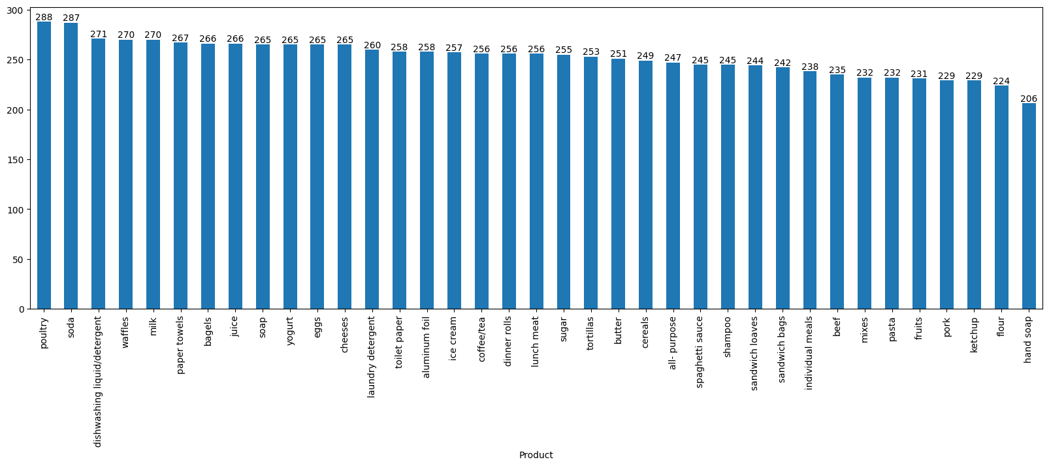
Top ordered products- 2019
Key Findings on Customer Demand
Analysis of 2019 transaction data reveals a high, concentrated demand across five key product categories, demonstrating customer preference for both essential and convenience items.
The top five products were ordered within a narrow range of 18 orders, indicating a nearly equal popularity among the leading items.
Rank | Product | Number of Orders | Percentage of Top 5 Total
1 | Poultry | 288 | 20.3%
2 | Soda | 287 | 20.2%
3 | Dishwashing Liquid | 271 | 19.1%
4 | Waffles | 270 | 19.1%
5 | Milk | 270 | 19.1%
TOTAL |  | 1,436 | 100%

Slide 16
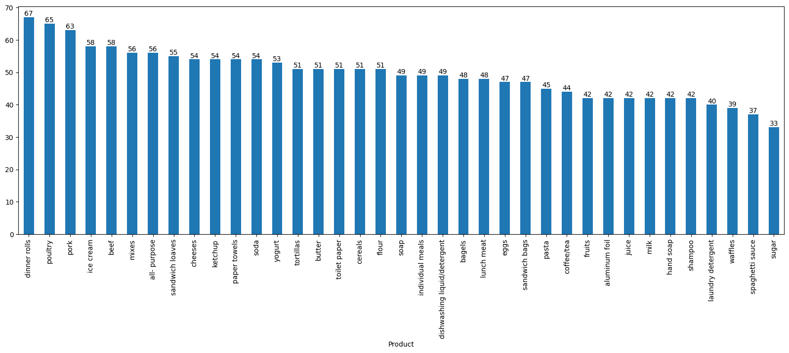
Top ordered products- 2020
Analysis of the 2020 transactional data (likely representing the beginning of the year) highlights a focused customer demand on specific meal components, particularly protein and prepared foods. The top five products were ordered within a tight range, from 58 to 67 orders, indicating a competitive and concentrated demand for these items.
Rank | Product | Number of Orders | Product Category
1 | Dinner Rolls | 67 | Prepared/Staple
2 | Poultry | 65 | Protein Staple
3 | Pork | 63 | Protein
4 | Ice Cream | 58 | Treat/Snack
5 | Beef | 58 | Protein Staple

Slide 17
Market Basket Analysis
Market Basket Analysis (MBA): is a foundational data mining technique used to discover non-obvious associations and patterns among products frequently purchased together by customers.
By thoroughly analyzing transactional (Point of Sale, or POS) data, MBA achieves two primary goals: understanding customer behavior and uncovering product relationships.
Key Function and Applications:
Generates Association Rules: MBA processes transactional data to produce "if-then" association rules (e.g., If a customer buys item X, Then they are likely to buy item Y). These rules are quantified by metrics like Support, Confidence, and Lift.
Optimizes Sales Strategies: The resulting insights allow businesses to make informed decisions that directly increase revenue and improve customer satisfaction. Key applications include:
Product Bundling: Creating special deals and discounts on popular combinations of products.
Cross-Selling: Strategic placement (online recommendations or physical store layout) of highly associated items.
Targeted Marketing: Personalizing promotional campaigns based on known customer preferences.
In essence, MBA turns raw purchase data into valuable insights that drive business growth by optimizing how and what products are offered to customers.

Slide 18
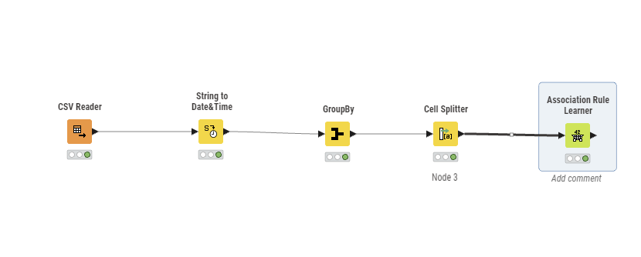

Slide 19
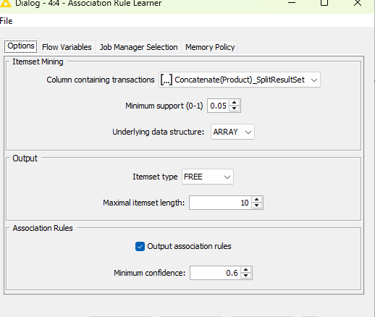
Threshold values of Support and Confidence

Slide 20
Threshold values of Support and Confidence Contd..
In this analysis, we have defined the threshold values for Support and Confidence as below:
Metric | Threshold Value | Purpose
Minimum Support | 0.05 (5%) | Ensures the item combination appears frequently enough in the overall dataset to be considered relevant.
Minimum Confidence | 0.6 (60%) | Ensures that the predictive power of the rule is high; meaning, if the antecedent (IF part) is purchased, the likelihood of the consequent (THEN part) also being purchased is at least 60%.
By applying these thresholds, the analysis filters out less common and unreliable rules, allowing the focus to remain on the associations that have strong statistical support and high predictive confidence. This ensures the resulting insights are meaningful and provide a solid foundation for informed business decisions, such as product bundling and cross-selling.

Slide 21
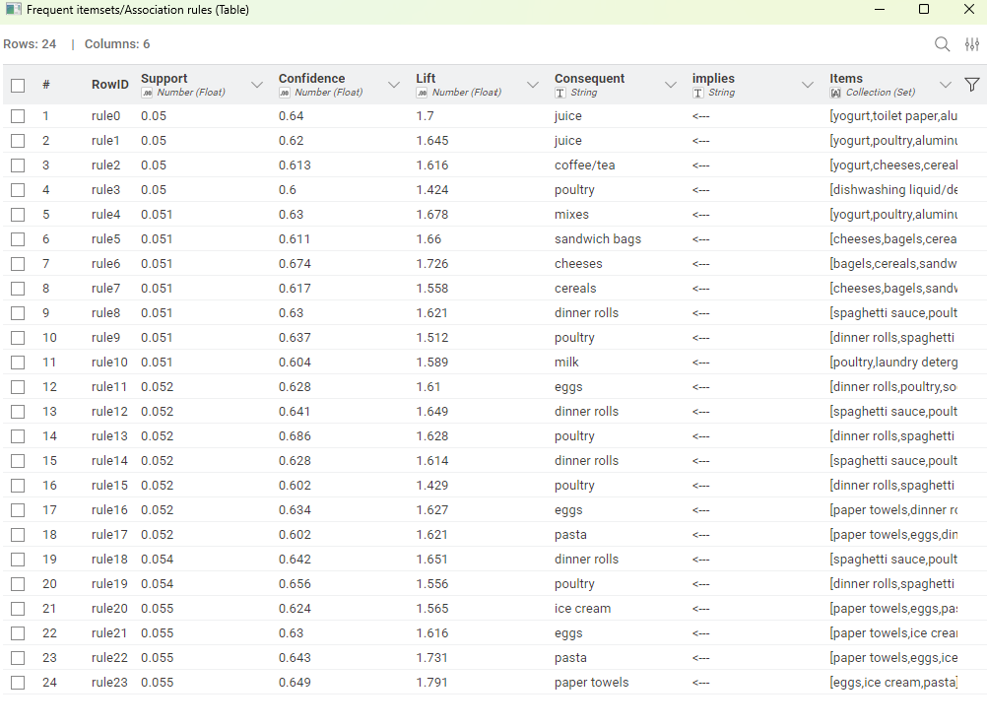
Association Representation

Slide 22

Support, Confidence, and Lift Values: Metrics for Association Analysis
Support: The support value represents the frequency or popularity of an itemset in the dataset. It indicates how often a specific combination of items appears together in customer transactions.
Confidence: Confidence measures the likelihood that a customer who buys one item will also purchase another item. It is calculated as the ratio of the number of transactions where both items are purchased together to the number of transactions where the first item is purchased.
Lift: Lift measures the strength of association between two items in an association rule. It compares the probability of the two items being purchased together to the probability of them being purchased independently. A lift value greater than 1 suggests a positive association, indicating that the items are more likely to be purchased together.

Slide 23
Support, Confidence, and Lift Values: Metrics for Association Analysis Contd….
The strength and value of an association rule (X→Y) are quantified using three core metrics: Support, Confidence, and Lift.
Metric | Definition | Calculation & Purpose
Support | Frequency and Popularity of an itemset. | Represents how often a specific combination of items ($X$ and $Y$) appears together relative to the total number of transactions. It identifies the most common itemsets in the dataset.
Confidence | Likelihood that a customer will purchase item Y, given they have already purchased item X. | Calculated as the ratio of transactions containing both $X$ and $Y$ to the transactions containing $X$ alone. It measures the predictive power of the rule ($X \rightarrow Y$).
Lift | Strength of Association between two items. | Compares the probability of items $X$ and $Y$ being purchased together to the probability of them being purchased independently (by chance). A Lift value greater than 1 indicates a positive association, meaning the items are more likely to be bought together.
 |  | A Lift value less than 1 suggests a negative association, and a value equal to 1 suggests no relationship.

Slide 24
Summary
There is high and consistent customer preference for a core set of staple and convenience goods, led by Poultry, Soda, and Cereals. The close order counts among the top five products across 2018 and 2019 (e.g., Poultry at 288 and Soda at 287 in 2019 ) indicate that demand is competitive and that even minor targeted promotions can significantly shift sales volume among these items. Products trailing in demand, such as Ketchup, hand soap, and pork, offer opportunities for strategic bundling with high-demand items.
Customer activity is significantly higher on the weekends. The number of orders and products sold increases consistently from Monday to Sunday. This strongly suggests that promotional efforts, inventory staging, and staffing levels should be heavily weighted toward the latter half of the week (Friday through Sunday) to capitalize on peak demand.
While product order activity was relatively stable from 2018 to 2019, the sharp decline noted in both orders and products sold in 2020 cannot be definitively interpreted as a long-term trend. This anomaly is due to insufficient data (only the first two months of 2020 were provided) and requires further data collection or external context to establish true year-over-year patterns. Similarly, the weekly and quarterly product sales show erratic patterns that need deeper investigation to establish any reliable trends.
The transactional data is suitable for Market Basket Analysis, as the 4,730 duplicate Order IDs correctly represent multiple items within a single transaction, forming the basis for association rules. The objective of identifying frequently purchased item combinations is achievable. By leveraging high-Lift association rules (e.g., {yogurt, toilet paper, aluminum foil} implies Juice ), the grocery store can implement profitable combo offers and strategic product placement to encourage customers to buy related items and increase the store’s revenue.
Over the course of three years, the analysis of customer orders reveals changing preferences and trends. In 2018, cereals, poultry, flour, shampoo, and lunch meat were popular choices, indicating a demand for everyday household items. In 2019, poultry, soda, dishwashing liquid, waffles, and milk took the lead, suggesting a mix of food and cleaning products. However, in 2020, there was a shift towards dinner rolls, poultry, pork, ice cream, and beef, showcasing a desire for more indulgent food options. This suggests a shift in customer preferences between the two years, indicating changing market trends.

Slide 25
Recommendations (discount offers/ combos)
High-Lift Cross-Selling Combos (MBA-Driven)
These promotions target the strongest, non-obvious associations (High Lift values) to drive sales of the consequent item (the "THEN" item).
Combo Strategy | Based on MBA Rule | Recommendation | Type
"The Dinner Prep Bundle" | {yogurt, toilet paper, aluminum foil} \rightarrow Juice (Lift: 1.7) | Offer 15% off Juice when a basket contains any two of the antecedent items (yogurt, toilet paper, aluminum foil). | Conditional Discount
"Weekend Breakfast Pack" | {bagels, cereals, sandwich bags} \rightarrow Milk (Lift: 1.726) | Create a Fixed-Price "Back-to-School/Work" Bundle offering Milk, Bagels, and Cereals for a discounted price. | Fixed Price Bundle
"Cleanup Combo" | {eggs, ice cream, pasta} \rightarrow paper towels (Lift: 1.791) | Offer a "Buy 2, Get Paper Towels 50% Off" deal when a customer buys Eggs and Ice Cream/Pasta. | High-Value Discount
"Protein Prep Discount" | {yogurt, poultry, aluminum foil} \rightarrow Juice (Lift: 1.645) | Provide a $1.00 off coupon for Juice at the point-of-sale when a customer purchases Poultry and Yogurt together. | Point-of-Sale Prompt

Slide 26
Recommendations (discount offers/ combos) Contd…
High-Demand Staple & Treat Bundles
Leverage top-selling staples (Poultry, Cereals) by pairing them with complementary or slightly lower-demand items (like Soda and Waffles) to increase volume.
Combo Strategy | Products Involved | Target Goal
The "Movie Night" Bundle | Soda (High Demand, Rank 2) + Ice Cream (High Demand) + Waffles (High Demand) | Create a $X "Movie Night" bundle price for the combination. Capitalizes on the pairing of treats, perfect for weekend buying.
The "Dinner Essentials" Deal | Poultry (Rank 1) + Dishwashing Liquid (Rank 3) | Offer a $2 discount on Dishwashing Liquid when Poultry is purchased. This encourages the sale of a household essential alongside a popular protein.
The "Baking Starter" Offer | Flour (2018 Rank 3) + Milk (2019 Rank 5) + Sugar (Lower Demand) | Bundle a common set of baking items, using two popular staples to drive the sale of a potentially slower-moving ingredient (Sugar).

Slide 27
Recommendations (discount offers/ combos) Contd…
Operational and Temporal Strategies
Utilize the store layout and weekly trend data to support promotional efforts without relying solely on price cuts.
Strategy Focus | Finding | Implementation
Product Placement | High Lift Rules (e.g., paper towels, aluminum foil) | Physically relocate Juice to be near the refrigerated dairy/yogurt section. Place Paper Towels near the high-spill categories like Ice Cream and Eggs.
Weekend Promotion Push | Orders peak Friday-Sunday. | Launch all combo offers and high-value discounts only from Friday morning to Sunday evening. This concentrates effort on the high-activity window and creates a sense of weekend urgency.
Promote Trailing Items | Ketchup, Hand Soap, Pork | Use items like Ketchup as the consequent item in a rule (e.g., "Buy Beef/Pork, Get Ketchup 50% Off") to clear inventory and re-establish demand.

Slide 28


